Slide 2

TABLE OF CONTENT
1
Findings
2
Recommendations

Slide 3
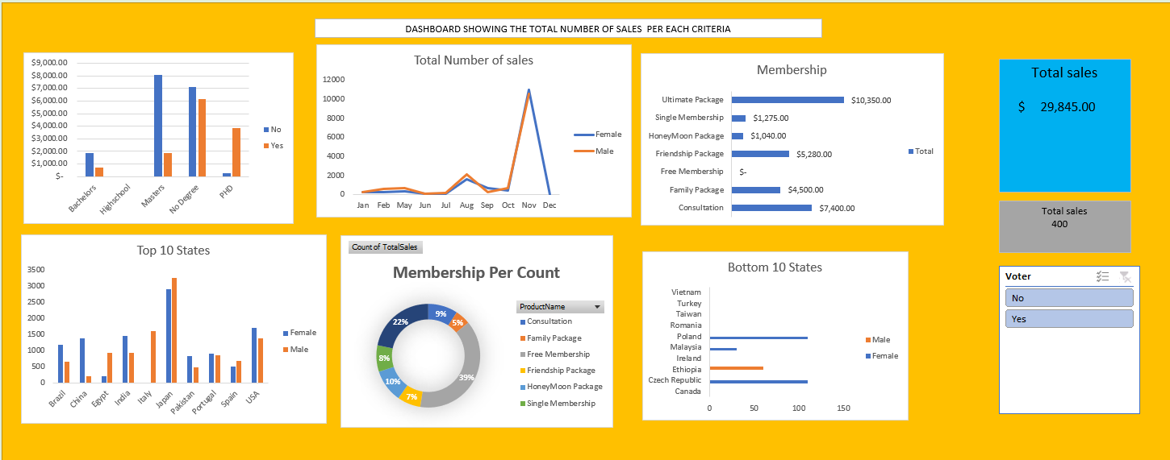
DASHBOARD

Slide 4

Findings

Slide 5
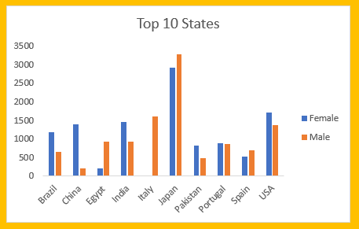
Highest Number of sales
Based on the data reviewed it was observed that Japan had the highest number of sales per region due to the following factors:
Effective market Strategies
Successful Product Features and
The competitive Pricing especially from ultimate package and Consultation.

Slide 6
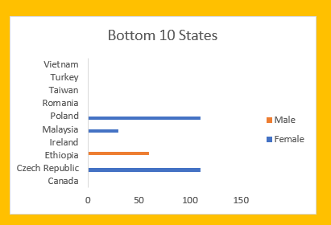
Lowest Number of Sales
A review of the data set showed that Vietnam, Turkey, Taiwan, and Romania had the lowest number of sales per region due to the following factors:
Cultural Preference
Economic Conditions
Market Saturation.

Slide 7
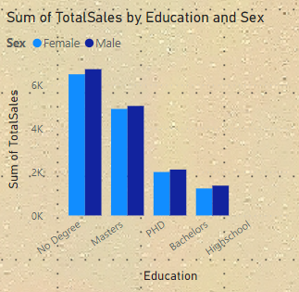
Total Number of Sales by Education.
A detailed analysis of the sample data showed that the customers with no degree had the highest number of sales, while the lowest sales was recorded amongst Bachelor degree holders.

Slide 8
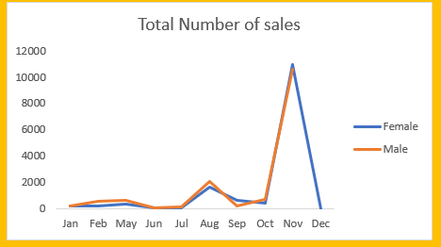
Annually Sales.
The analysis of the sample data showed that sales peaked in November and totally crashed in December.

Slide 9
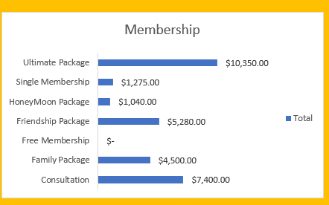
Total Number of Sales by Membership
Based on the findings, Ultimate package recorded the highest number of sales while the free membership package had no sales.

Slide 10
Recommendation

Slide 11




Recommendation
1
3
Collaboration with local Influencers and Partners to increase visibility and credibility in the targeted countries such as Vietnam,Taiwan,Turkey and Romania
Implement targeted marketing campaigns that highlight the unique benefitsof our membership to the local audience.
Regularly evaluate the market dynamics to stay adaptable and responsive to change in consumer behaviour.
Collect feedback from customers from those regions to continuously refine and optimize our offerings based on their preferences and needs.
2
4

Slide 12
THANK YOU

